Slide 1
Transformer Review
By Dequan Er

Slide 2
Outline
Introduction
Model architecture
Result
Derived models
Applications

Slide 3
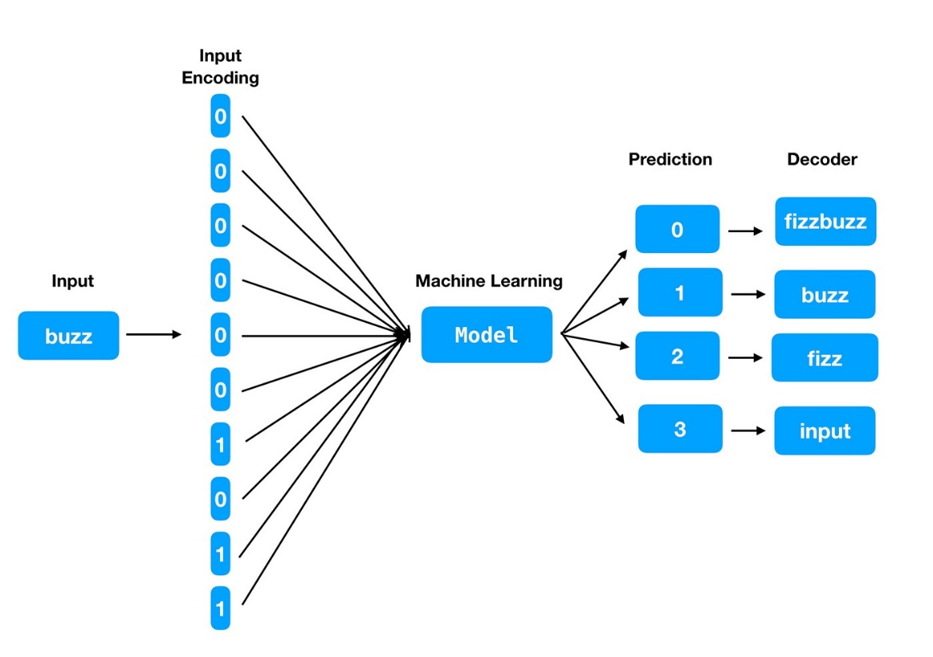
Introduction
From Sequence Modeling to Attention (2017)
From NLP problem
RNN, LSTM, GRU
From recurrent language models to encoder-decoder model
H_{t-1} to h_{t}
Hard to parallelize
Long sequence memory lose, large H_{t}
Attention used from encoder to decoder
Derivatives of Transformers
BERT (2018), GPT3 (2020)
ChatGPT(2022)
From NLP to audio, video, etc.
Notes:
Bidirectional Encoder Representations from Transformers (BERT)
Generative Pre-trained Transformer

Slide 4
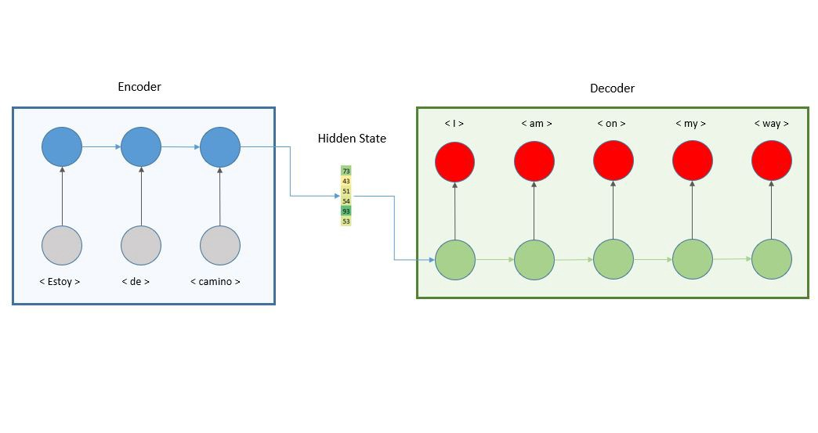
Model Architecture
Structure of encoder-decoder

Slide 5
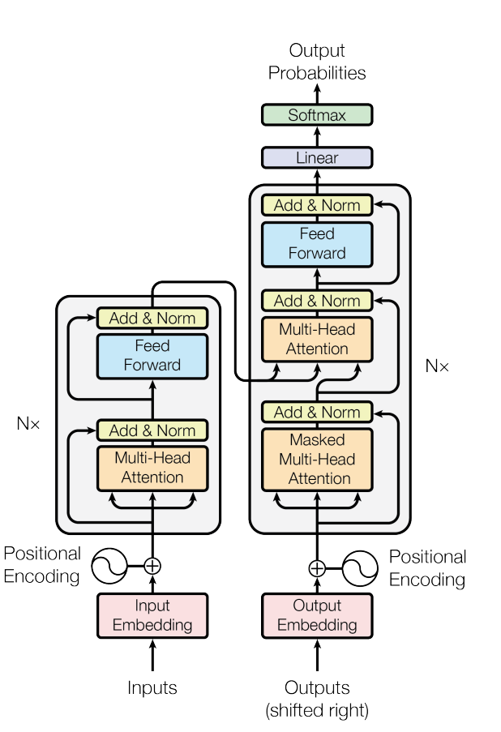
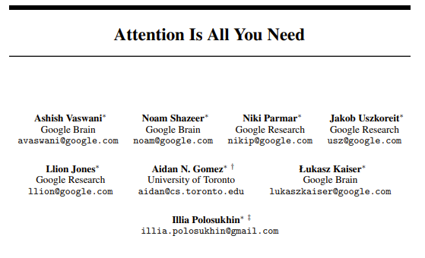
Model Architecture
31st Conference on Neural Information Processing Systems (NIPS 2017), Long Beach, CA, USA.

Slide 6
Model Architecture
Attention layer: mapping a query and a set of key-value pairs to an output in vector form.
Q
V
k

Slide 7
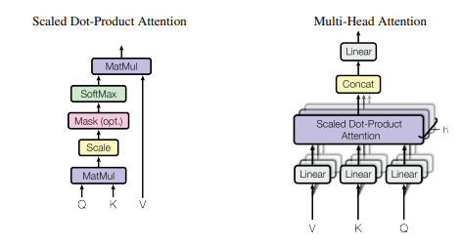

Model Architecture
Scaled dot-product attention
Notes:
Demo on mask layer

Slide 8
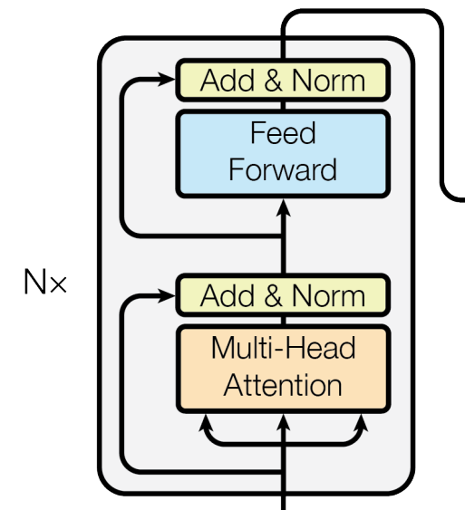
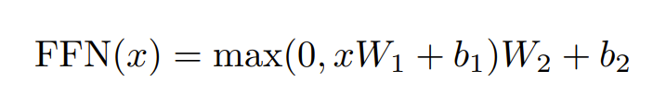
Model Architecture
Position-wise Feed-Forward Networks
Positional Encoding
Ensure sequence of tokens
Notes:
Drawing of layer
H_t = k1, k2, …k_t-1 kn masked

Slide 9
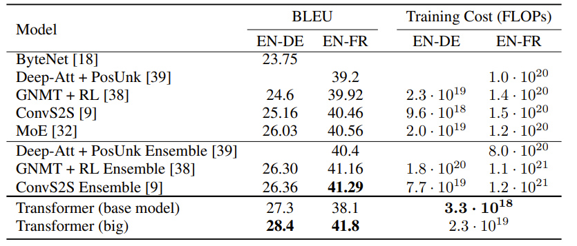
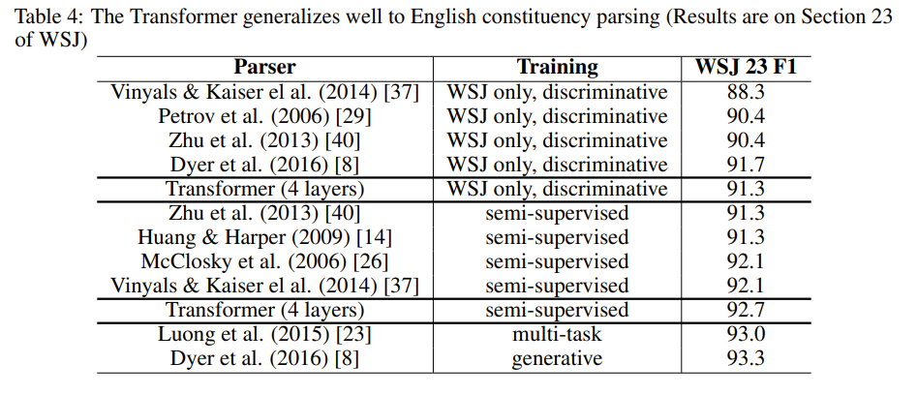
Result

Slide 10
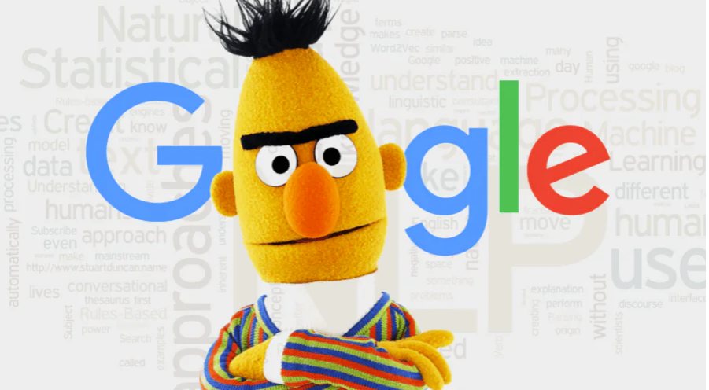
Derived models
BERT: https://www.codemotion.com/magazine/ai-ml/bert-how-google-changed-nlp-and-how-to-benefit-from-this/
GPT: https://huggingface.co/docs/transformers/model_doc/openai-gpt
GPT3: https://github.com/openai/gpt-3
ChatGPT: https://openai.com/blog/chatgpt/
It has 175 Bn parameters

Slide 11
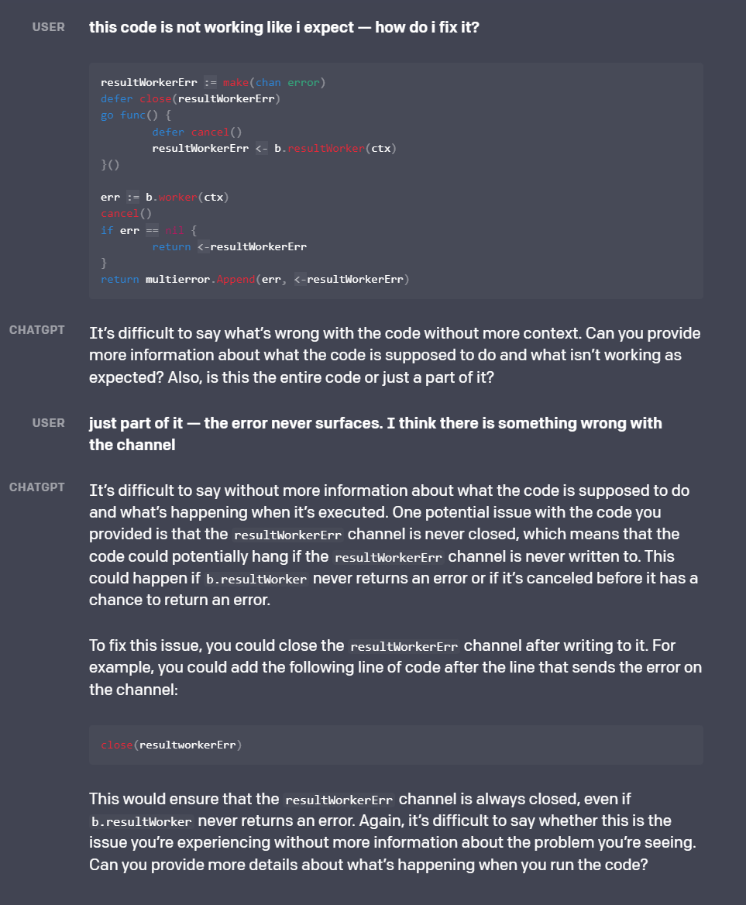
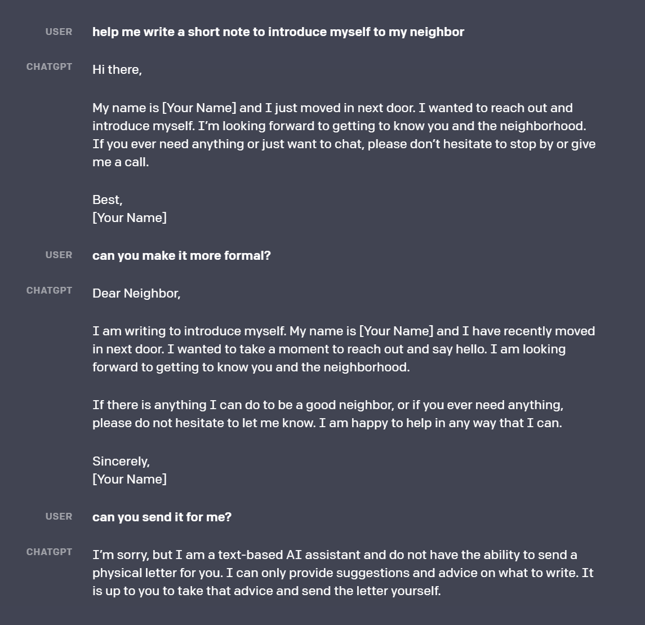
ChatGPT

Slide 12
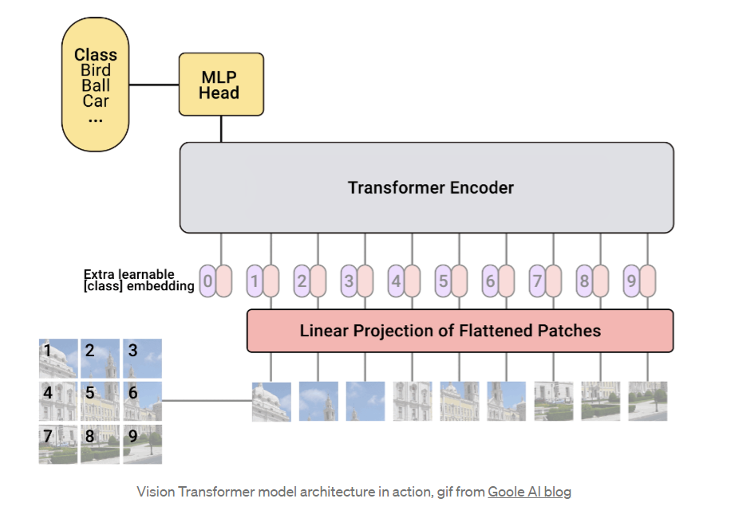
Applications
NLP
Sentiment analysis
Vision Transformers
ViT (2020)
Swin Transformer (2021)
DINO, DETR …
Audio

Slide 13
Q&A

